Slide 2
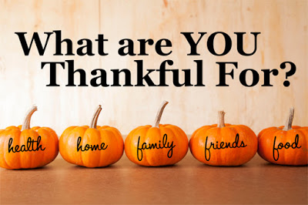

Slide 3
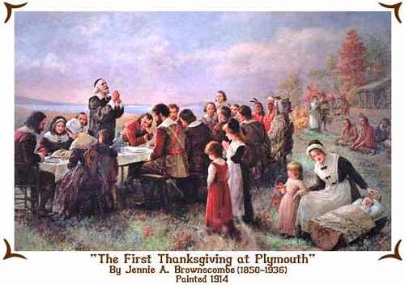

Slide 4
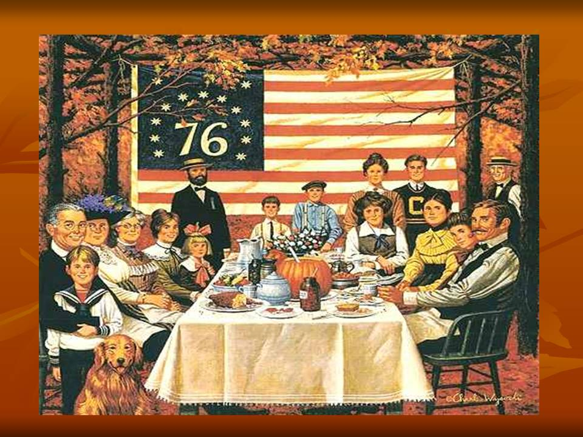
Thanksgiving Day is celebrated in the United States on the last Thursday in November. This holiday is one of the big six major holidays of the year. People of all faiths celebrate this day. They give thanks for the many good things in their lives.

Slide 5
Thanksgiving Day has been an official United States holiday since 1863, when President Abraham Lincoln, proclaimed that Thursday, 26 November, should be a day of national gratitude. Before that this holiday celebrated English settlers of the Plymouth colony, who had to endure a rough first winter in New England.

Slide 6
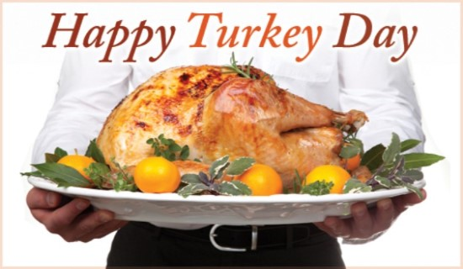
Thanksgiving Day is a traditional family holiday. So on that day families always come together, especially for the wonderful meal. A large roasted turkey with stuffing is the most common main dish of a Thanksgiving dinner, that’s why Thanksgiving is sometimes called “Turkey Day”.

Slide 9
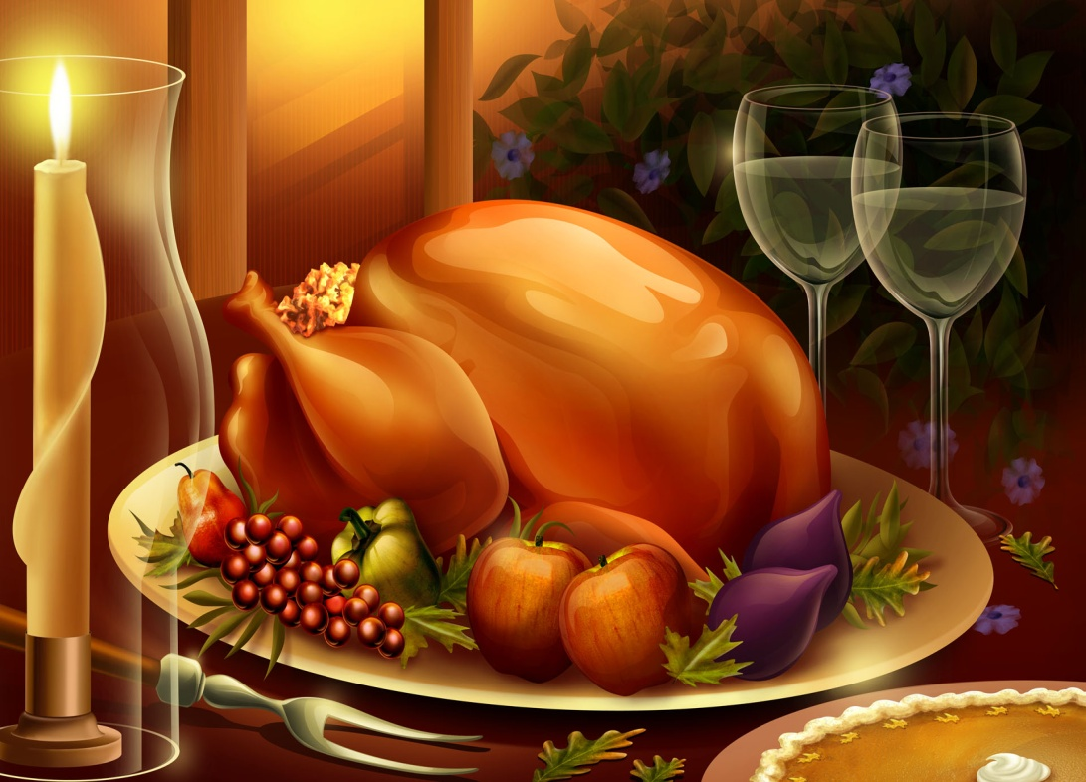
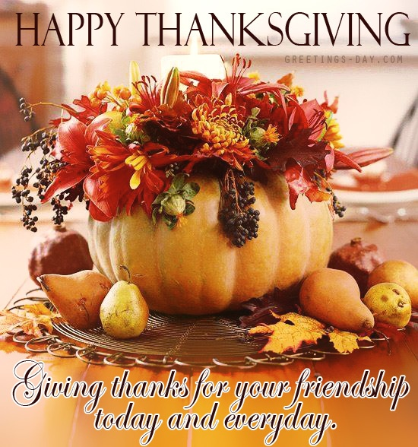
Thanksgiving dinner almost always includes some of the foods served at the first feast: roast turkey, cranberry sauce, potatoes, pumpkin pie. Before the meal begins, families or friends usually pause to give thanks for their blessings, including the joy of being united for the occasion.

Slide 10
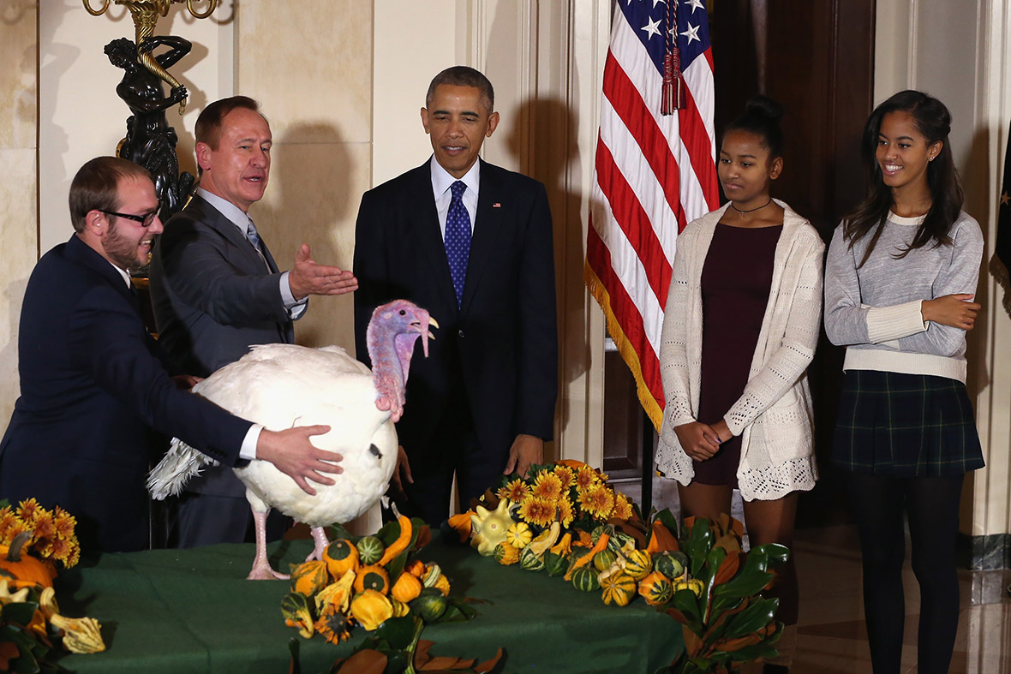
Thanksgiving Day is a national holiday celebrated in Canada and
The United States of America

